Slide 1
Human Matting
2020 PEOPLESPACE PROJECT

Slide 2
01
What is the human Matting?
02
Training
02
Front-End
03
Back-End
04
Overall Process
CONTENTS
05
Future Work

Slide 3
What is the Human Matting?

Slide 4



What is Human Matting ?
Extracting humans from natural images with high quality

Slide 5
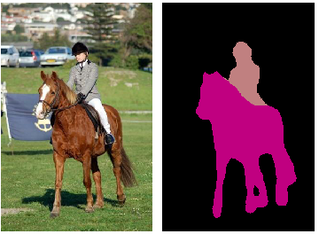
Semantic Human matting
How to Design Automatic Human Matting ?
Semantic Segmentations
Can identifies the object category of each pixel directly! (Pros)
But it blur structural details ! (Cons)

Slide 6
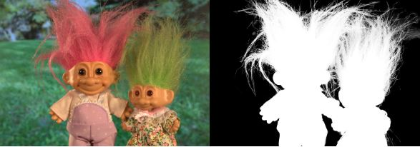
Semantic Human matting
How to Design Automatic Human Matting ?
2. Image matting
Widely adopted for “fine detail” extraction!(Pros)
Not suitable in data-sensitive or time-sensitive situations! (Cons)

Slide 7
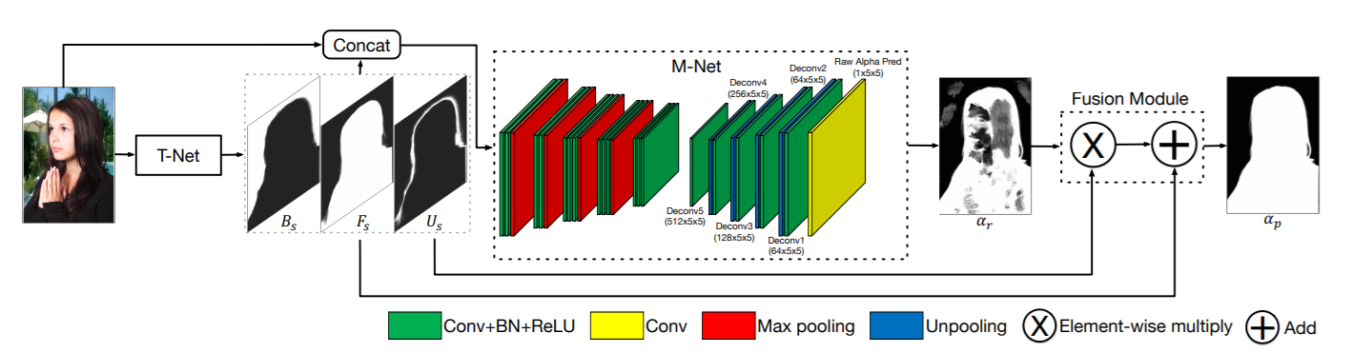
Semantic Human matting
So, why don’t we combine two systems mentioned before?
Input Image
(RGB channel)
T-Net
(Segmentation)
M-Net
(Image Matting)
Output Image
(extract foreground)

Slide 8
Data Curation

Slide 9
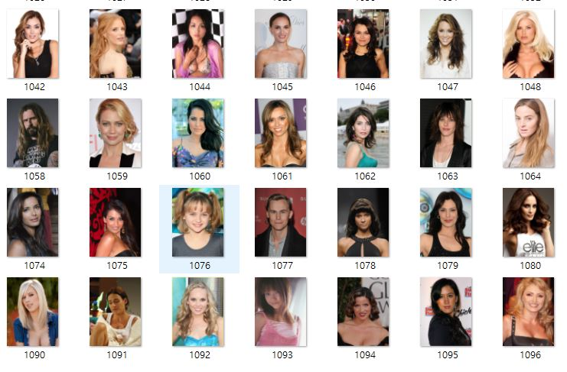
Prepare Human dataset
For model with better performance, we collected all 43,000 human original dataset!

Slide 10
Prepare Human dataset
We splited human dataset into train, validation, and test set!
By using pytorch built-in function ‘random_split’
Train dataset : Validation dataset = 8 : 2

Slide 11

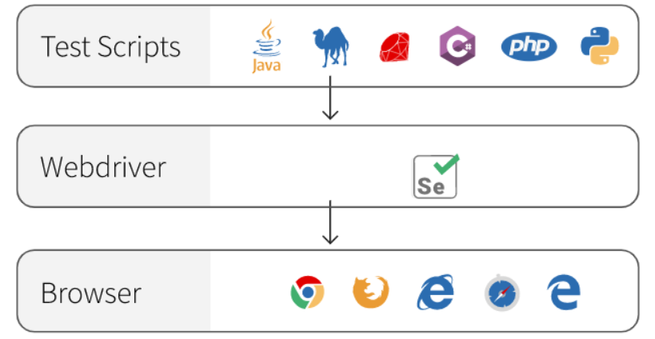
Prepare Human dataset
We used “removebg API” by using selenium webdriver, and got human matted image! -> Groundtruth!

Slide 12



Learn human dataset (Overall structure)
Predicted human matte
Calculate difference
-> evaluate model performance
Groundtruth
human matte
(source: https://github.com/lizhengwei1992/Semantic_Human_Matting)

Slide 13
Training

Slide 14
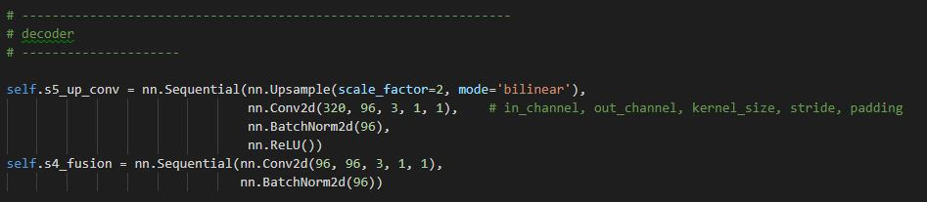
Training (In Google Cloud Platform)
Using Pytorch library
Dataset : 31707
Train(25365) validation (6342)
Learning rate : 0.0005
Epoch : 100
Apply Batch normalization, Dropout, and Weight decay to our model

Slide 15
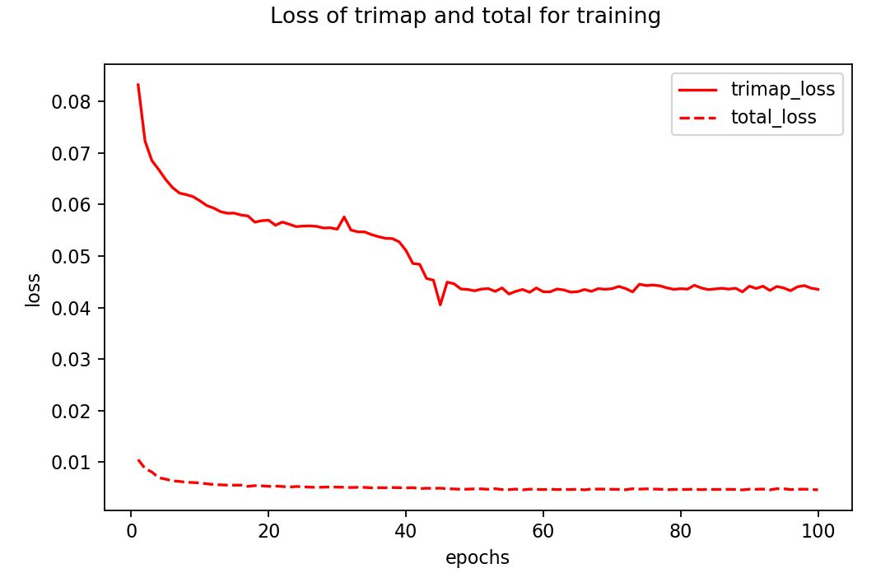
Training Result
Converge

Slide 16
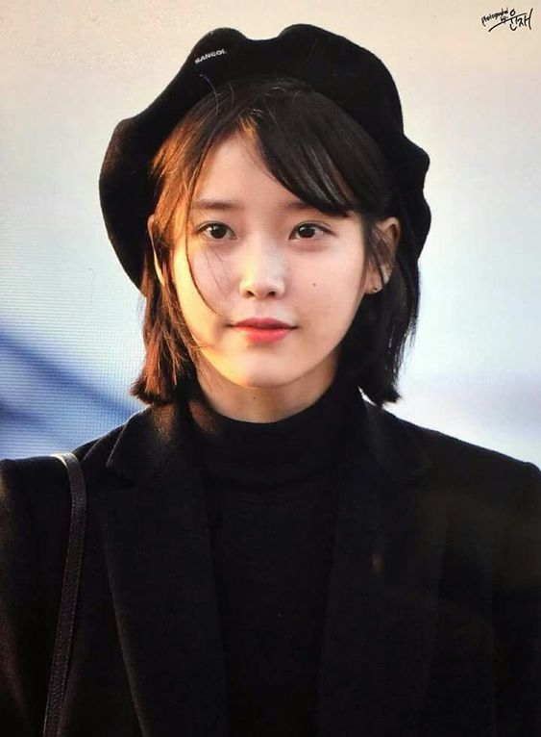
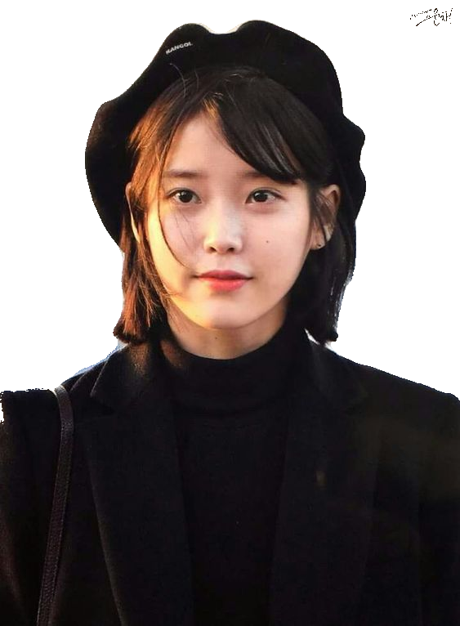
Training Result
Input
Output

Slide 17

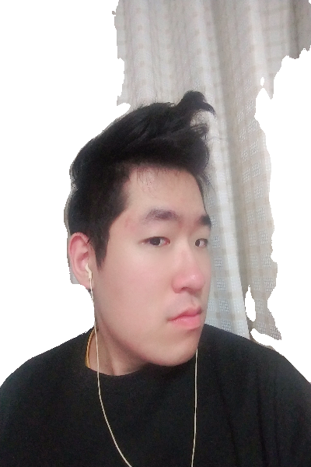
Training Result
Input
Output

Slide 18
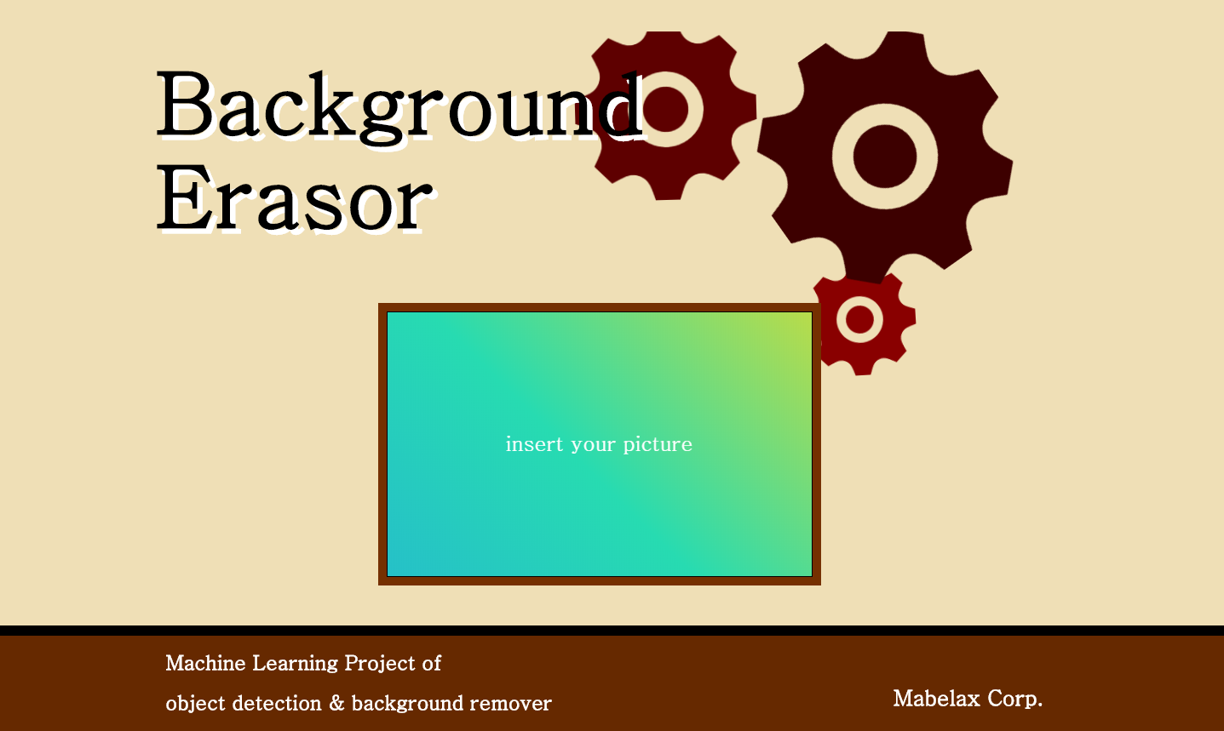
Front-end

Slide 19

Back-end
Web application framework powered by Python
Role of the server
1. Receive image data from user
2. Process the data according to the purpose
→ Run our trained human matting model
3. Deliver matted images to the user as a result of model execution

Slide 20
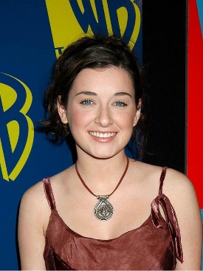
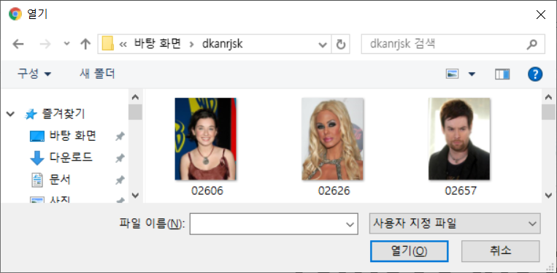

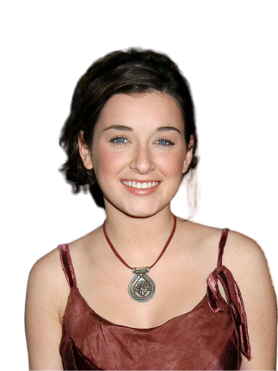
Overall Process
Web
Server
Image file received
submit
Resize cvtColor …
Image preprocessing
Run trained model
Submit a image
Output image
Show result

Slide 21
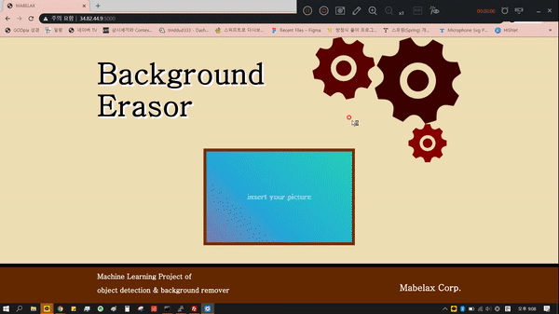
DEMO

Slide 22
Future Work
Improvement
More epoch
Try another network
Full body data collection & learning
Applications
1. Select specific objects for background removal
2. Change to the background you want

Slide 23
THANK YOU

